Slide 1


Slide 2


Slide 3

SUBHEADLINE
Staying Flexible
Two-Column Slide
Column One
Column Two
Paragraph header. Tawineg apowniegokanw aweogaopweg awegwerg awerwer aerbgaerb aerbaerb aoerpjhprt aerbgaerb.
  Body copy. Equideratius es rerundam nus. Di solupti sit quatestiunt. Fuga. Genda id que et facillab inctiorem ium dellore perchil igenditios ut aliquia.
    Add your bullet points here
Paragraph header. Tawineg apowniegokanw aweogaopweg awegwerg awerwer aerbgaerb aerbaerb aoerpjhprt aerbgaerb.
  Body copy. Equideratius es rerundam nus. Di solupti sit quatestiunt. Fuga. Genda id que et facillab inctiorem ium dellore perchil igenditios ut aliquia.
    Add your bullet points here

Slide 4

SUBHEADLINE
In the
Bubble
Two-Column Slide
Column One
Column Two
Paragraph header. Tawineg apowniegokanw aweogaopweg awegwerg awerwer aerbgaerb aerbaerb aoerpjhprt aerbgaerb.
  Body copy. Equideratius es rerundam nus. Di solupti sit quatestiunt. Fuga. Genda id que et facillab inctiorem ium dellore perchil igenditios ut aliquia.
    Add your bullet points here
Paragraph header. Tawineg apowniegokanw aweogaopweg awegwerg awerwer aerbgaerb aerbaerb aoerpjhprt aerbgaerb.
  Body copy. Equideratius es rerundam nus. Di solupti sit quatestiunt. Fuga. Genda id que et facillab inctiorem ium dellore perchil igenditios ut aliquia.
    Add your bullet points here

Slide 5
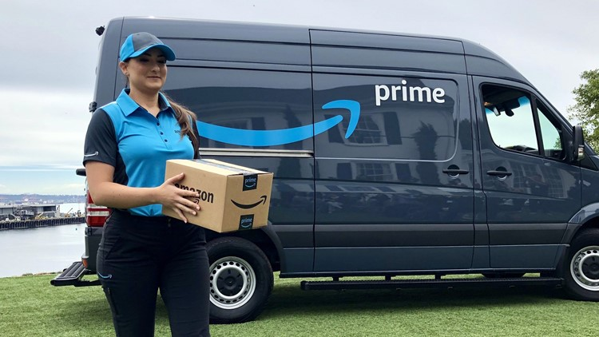

SUBHEADLINE
Delivering
Two-Column Slide
Column One
Column Two
Paragraph header. Tawineg apowniegokanw aweogaopweg awegwerg awerwer aerbgaerb aerbaerb aoerpjhprt aerbgaerb.
  Body copy. Equideratius es rerundam nus. Di solupti sit quatestiunt. Fuga. Genda id que et facillab inctiorem ium dellore perchil igenditios ut aliquia.
    Add your bullet points here
Paragraph header. Tawineg apowniegokanw aweogaopweg awegwerg awerwer aerbgaerb aerbaerb aoerpjhprt aerbgaerb.
  Body copy. Equideratius es rerundam nus. Di solupti sit quatestiunt. Fuga. Genda id que et facillab inctiorem ium dellore perchil igenditios ut aliquia.
    Add your bullet points here

Slide 6
2020 Annual Update
Overall Market
Submarket | Number Of Buildings | Inventory | Total Available | Available % | Total Vacant | Vacant %
North | 349 | 40,558,613 | 3,711,384 | 9.2% | 2,273,752 | 5.6%
West | 350 | 30,499,502 | 1,047,199 | 3.4% | 717,582 | 2.4%
Central | 194 | 23,490,340 | 5,798,386 | 24.7% | 3,670,912 | 15.6%
South | 171 | 22,446,411 | 2,528,081 | 11.3% | 1,872,900 | 8.3%
Kenosha | 135 | 29,207,542 | 2,692,565 | 9.2% | 1,136,544 | 3.9%
TOTAL | 1,199 | 146,202,408 | 15,777,615 | 10.8% | 9,671,690 | 6.6%
Compared to 2019 | +17 | +6,464,206 | +1,126,678 | +0.3% | +665,130 | +0.2%
By the numbers
146M
+6.5M
square feet inventory
15.8M
+1.1M
square feet available
9.7M
+665K
square feet vacant
6.6%
+0.2%
vacancy rate

Slide 7
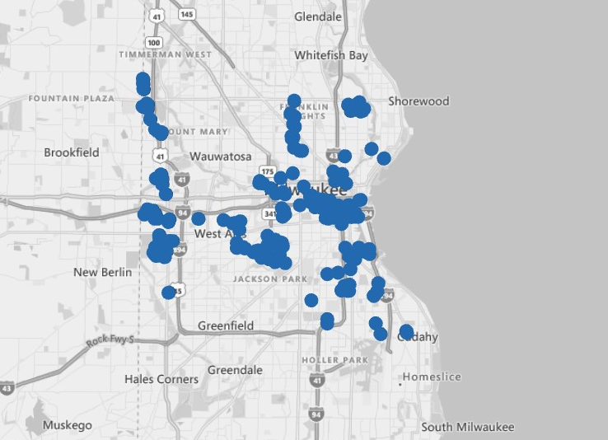
2020 Annual Update
Central Submarket
Submarket | Number Of Buildings | Inventory | Total Available | Available % | Total Vacant | Vacant %
North | 349 | 40,558,613 | 3,711,384 | 9.2% | 2,273,752 | 5.6%
West | 350 | 30,499,502 | 1,047,199 | 3.4% | 717,582 | 2.4%
Central | 194 | 23,490,340 | 5,798,386 | 24.7% | 3,670,912 | 15.6%
South | 171 | 22,446,411 | 2,528,081 | 11.3% | 1,872,900 | 8.3%
Kenosha | 135 | 29,207,542 | 2,692,565 | 9.2% | 1,136,544 | 3.9%
TOTAL | 1,199 | 146,202,408 | 15,777,615 | 10.8% | 9,671,690 | 6.6%
Compared to 2019 | +17 | +6,464,206 | +1,126,678 | +0.3% | +665,130 | +0.2%
By the numbers
23.5M
+16K
square feet inventory
5.8M
-322K
square feet available
3.7M
-257K
square feet vacant
15.6%
-1.1%
vacancy rate

Slide 8
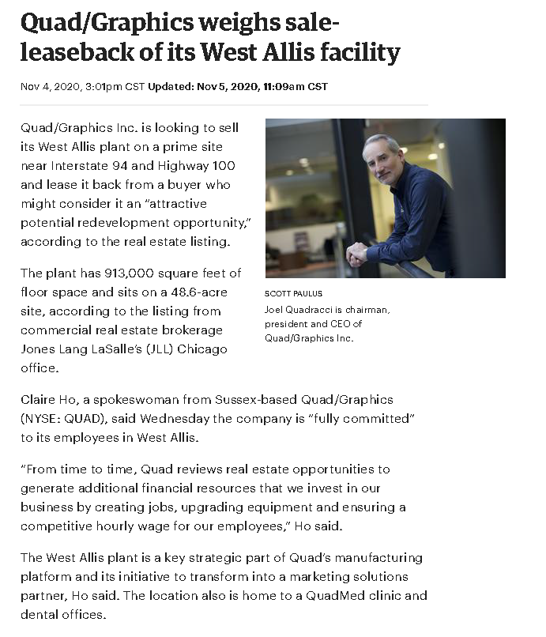

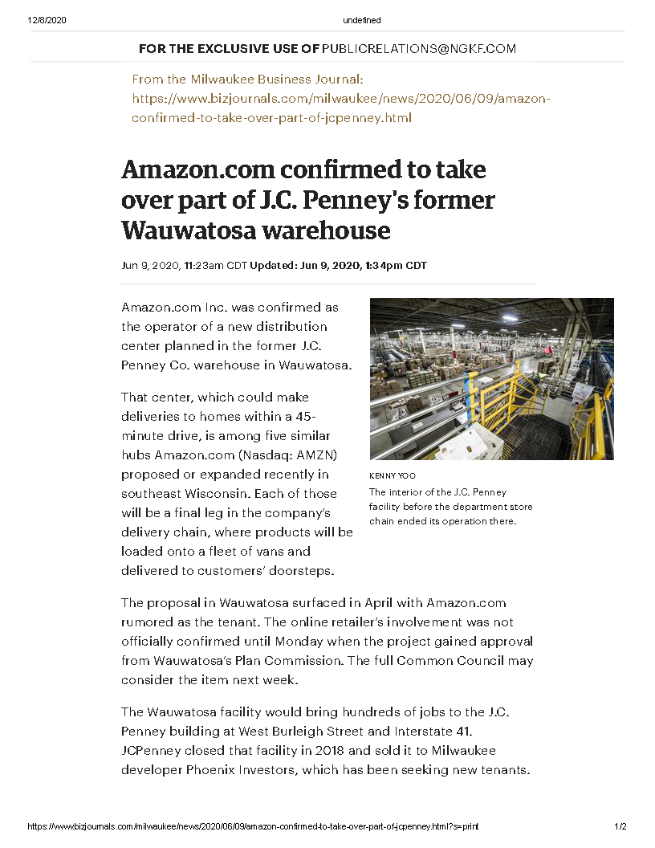
2020 Annual Update
Central Submarket
In the News
#1
#2
#3
Amazon could take over part of massive former

Slide 9
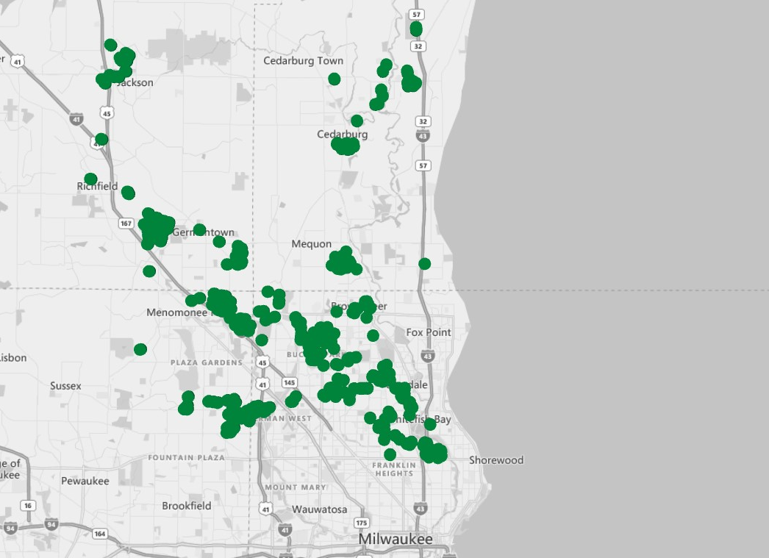
2020 Annual Update
North Submarket
Submarket | Number Of Buildings | Inventory | Total Available | Available % | Total Vacant | Vacant %
North | 349 | 40,558,613 | 3,711,384 | 9.2% | 2,273,752 | 5.6%
West | 350 | 30,499,502 | 1,047,199 | 3.4% | 717,582 | 2.4%
Central | 194 | 23,490,340 | 5,798,386 | 24.7% | 3,670,912 | 15.6%
South | 171 | 22,446,411 | 2,528,081 | 11.3% | 1,872,900 | 8.3%
Kenosha | 135 | 29,207,542 | 2,692,565 | 9.2% | 1,136,544 | 3.9%
TOTAL | 1,199 | 146,202,408 | 15,777,615 | 10.8% | 9,671,690 | 6.6%
Compared to 2019 | +17 | +6,464,206 | +1,126,678 | +0.3% | +665,130 | +0.2%
By the numbers
40.5M
+590K
square feet inventory
3.7M
+342K
square feet available
2.8M
+522K
square feet vacant
5.6%
+1.2%
vacancy rate

Slide 10
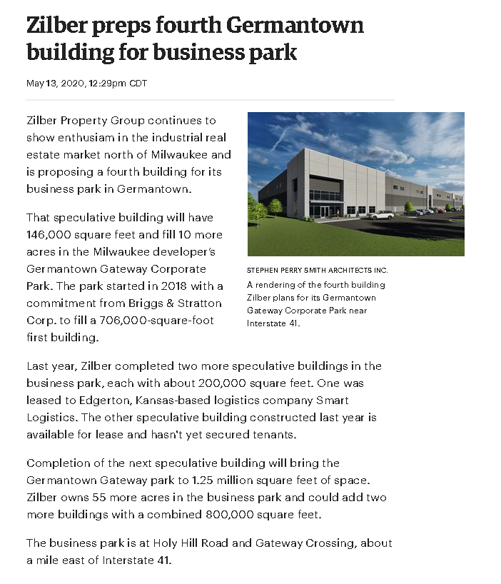

2020 Annual Update
North Submarket
In the News
#1
#2
#3

Slide 11
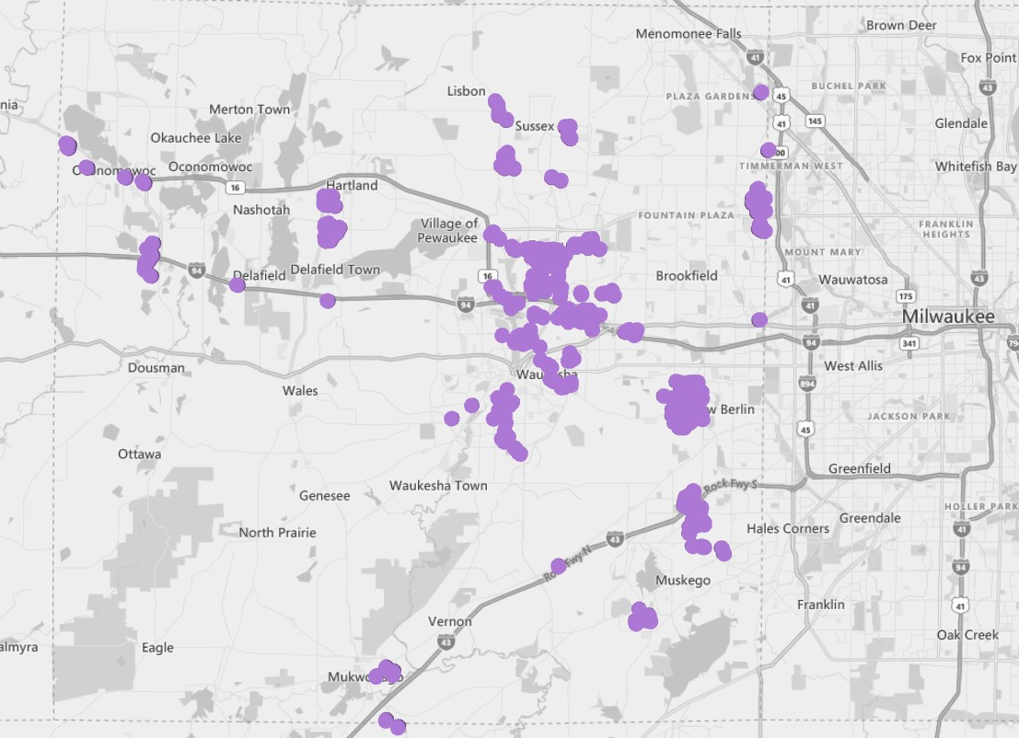
2020 Annual Update
West Submarket
Submarket | Number Of Buildings | Inventory | Total Available | Available % | Total Vacant | Vacant %
North | 349 | 40,558,613 | 3,711,384 | 9.2% | 2,273,752 | 5.6%
West | 350 | 30,499,502 | 1,047,199 | 3.4% | 717,582 | 2.4%
Central | 194 | 23,490,340 | 5,798,386 | 24.7% | 3,670,912 | 15.6%
South | 171 | 22,446,411 | 2,528,081 | 11.3% | 1,872,900 | 8.3%
Kenosha | 135 | 29,207,542 | 2,692,565 | 9.2% | 1,136,544 | 3.9%
TOTAL | 1,199 | 146,202,408 | 15,777,615 | 10.8% | 9,671,690 | 6.6%
Compared to 2019 | +17 | +6,464,206 | +1,126,678 | +0.3% | +665,130 | +0.2%
By the numbers
30.5M
+681K
square feet inventory
1.05M
+21K
square feet available
717K
+105K
square feet vacant
2.4%
+0.3%
vacancy rate

Slide 12
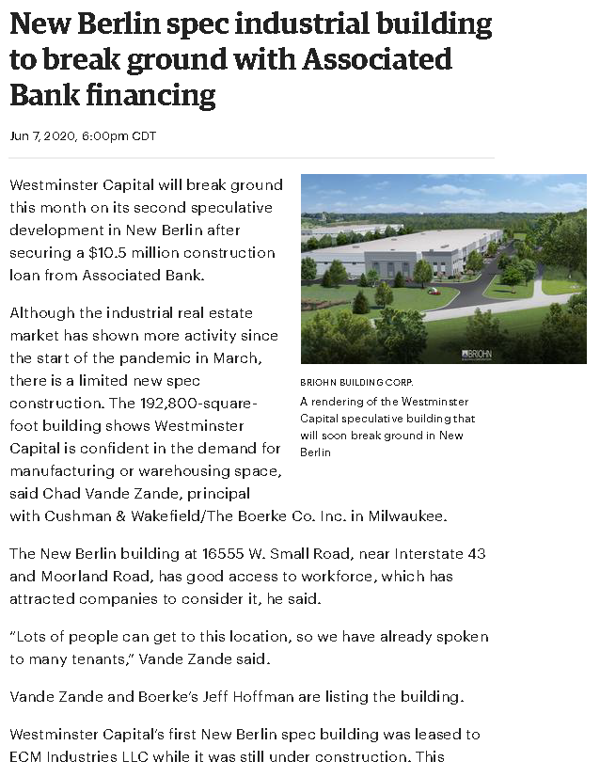
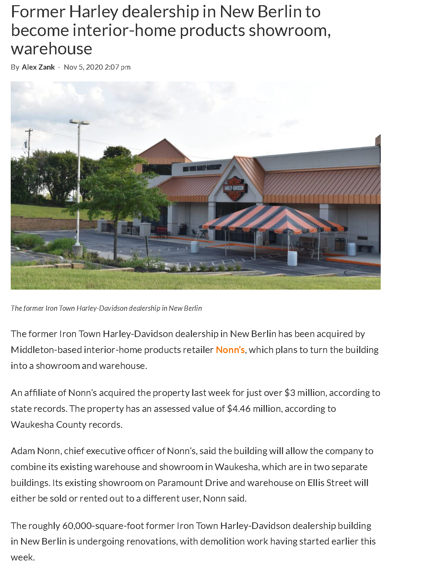
2020 Annual Update
West Submarket
In the News
#1
#2
#3

Slide 13
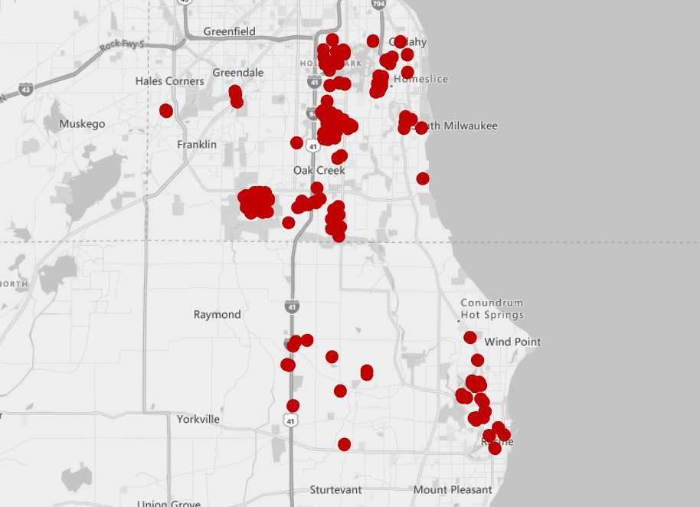
2020 Annual Update
South Submarket
Submarket | Number Of Buildings | Inventory | Total Available | Available % | Total Vacant | Vacant %
North | 349 | 40,558,613 | 3,711,384 | 9.2% | 2,273,752 | 5.6%
West | 350 | 30,499,502 | 1,047,199 | 3.4% | 717,582 | 2.4%
Central | 194 | 23,490,340 | 5,798,386 | 24.7% | 3,670,912 | 15.6%
South | 171 | 22,446,411 | 2,528,081 | 11.3% | 1,872,900 | 8.3%
Kenosha | 135 | 29,207,542 | 2,692,565 | 9.2% | 1,136,544 | 3.9%
TOTAL | 1,199 | 146,202,408 | 15,777,615 | 10.8% | 9,671,690 | 6.6%
Compared to 2019 | +17 | +6,464,206 | +1,126,678 | +0.3% | +665,130 | +0.2%
By the numbers
22.4M
+2.5M
square feet inventory
2.5M
+784K
square feet available
1.9M
+834K
square feet vacant
8.3%
+3.1%
vacancy rate

Slide 14
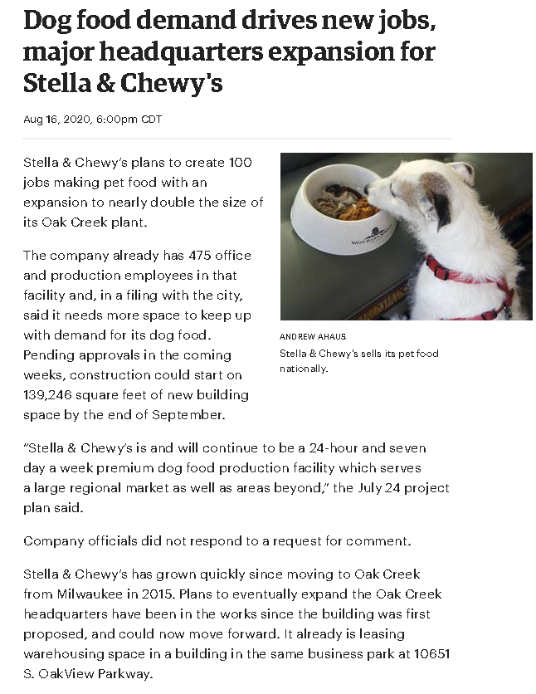
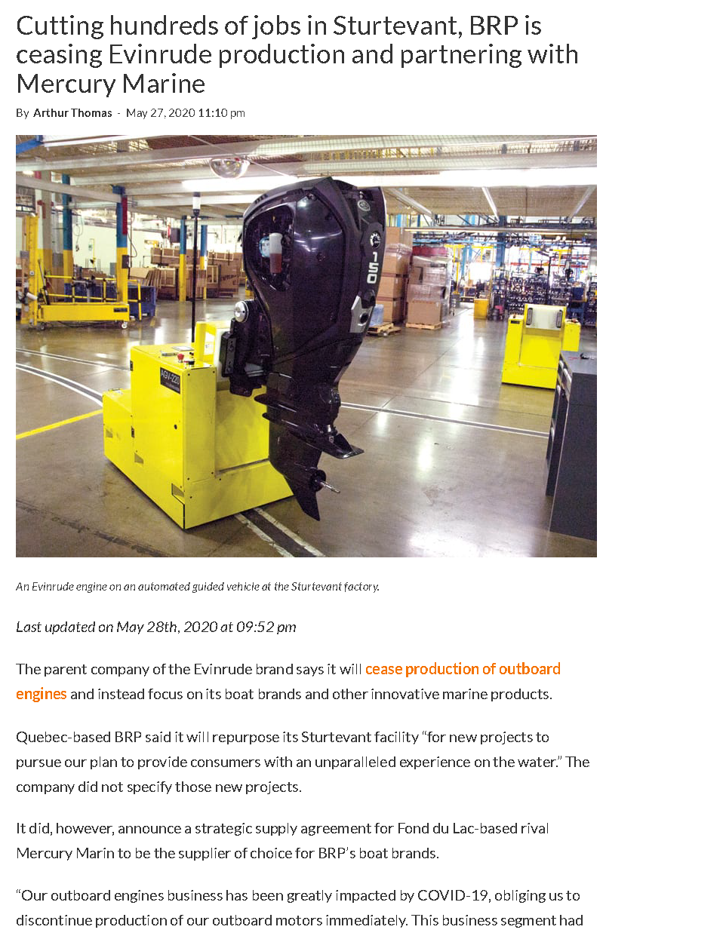
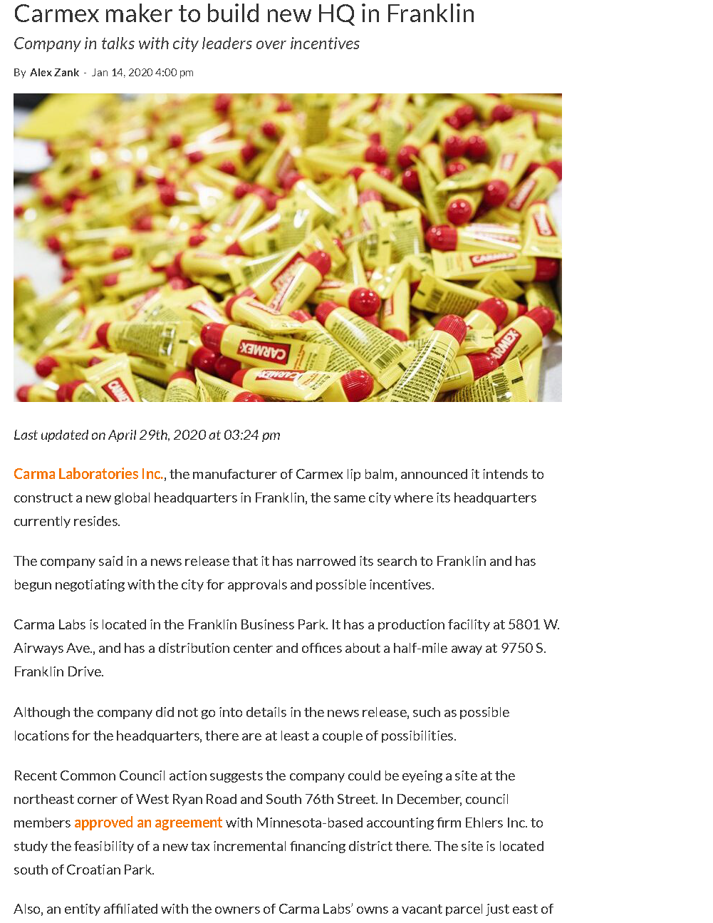
2020 Annual Update
South Submarket
In the News
#1
#2
#3

Slide 15
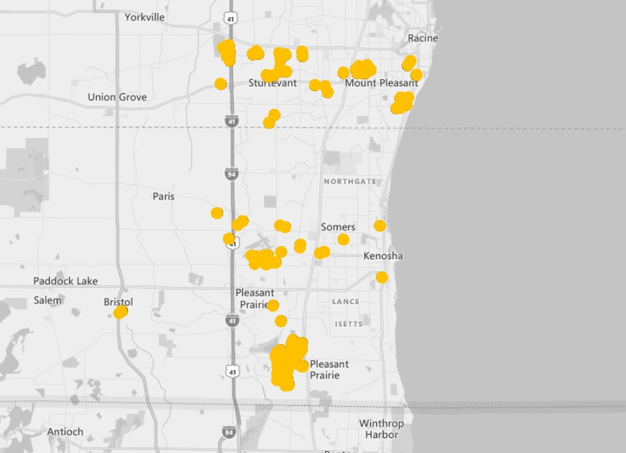
2020 Annual Update
Kenosha Submarket
Submarket | Number Of Buildings | Inventory | Total Available | Available % | Total Vacant | Vacant %
North | 349 | 40,558,613 | 3,711,384 | 9.2% | 2,273,752 | 5.6%
West | 350 | 30,499,502 | 1,047,199 | 3.4% | 717,582 | 2.4%
Central | 194 | 23,490,340 | 5,798,386 | 24.7% | 3,670,912 | 15.6%
South | 171 | 22,446,411 | 2,528,081 | 11.3% | 1,872,900 | 8.3%
Kenosha | 135 | 29,207,542 | 2,692,565 | 9.2% | 1,136,544 | 3.9%
TOTAL | 1,199 | 146,202,408 | 15,777,615 | 10.8% | 9,671,690 | 6.6%
Compared to 2019 | +17 | +6,464,206 | +1,126,678 | +0.3% | +665,130 | +0.2%
By the numbers
29.2M
+2.6M
square feet inventory
2.7M
+335K
square feet available
1.1M
-539K
square feet vacant
3.9%
-2.4%
vacancy rate

Slide 16
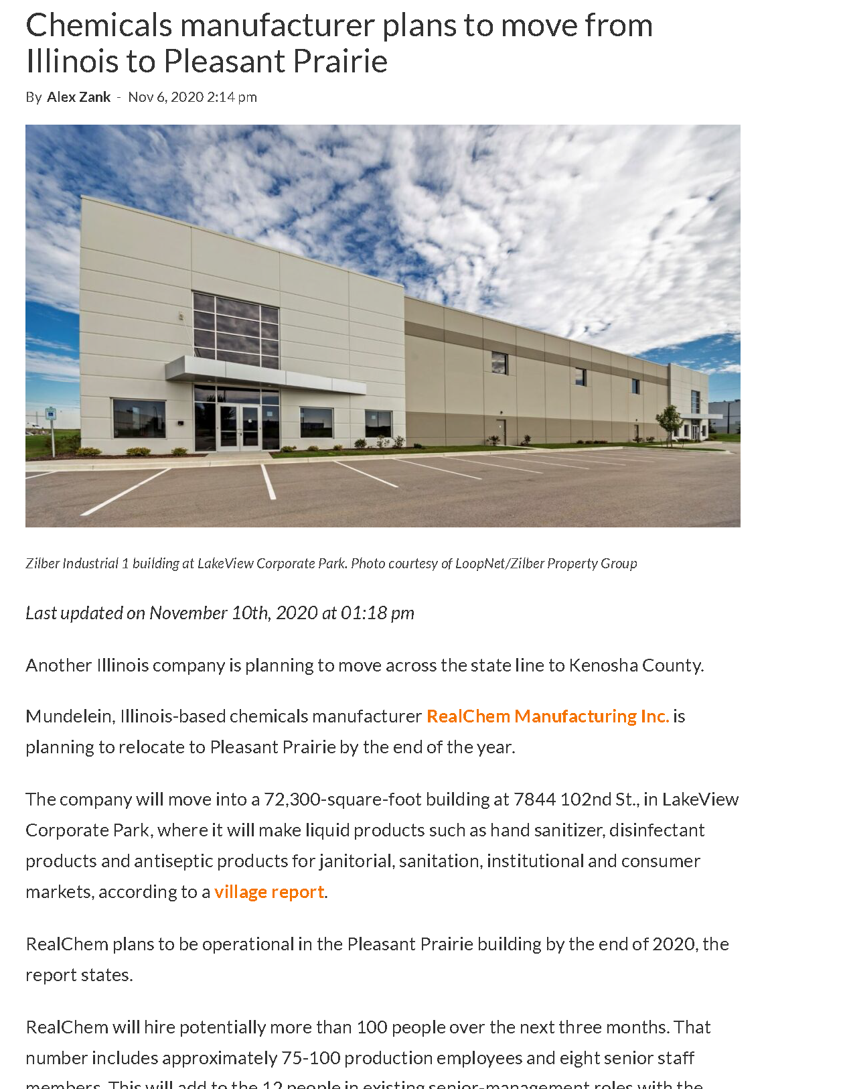

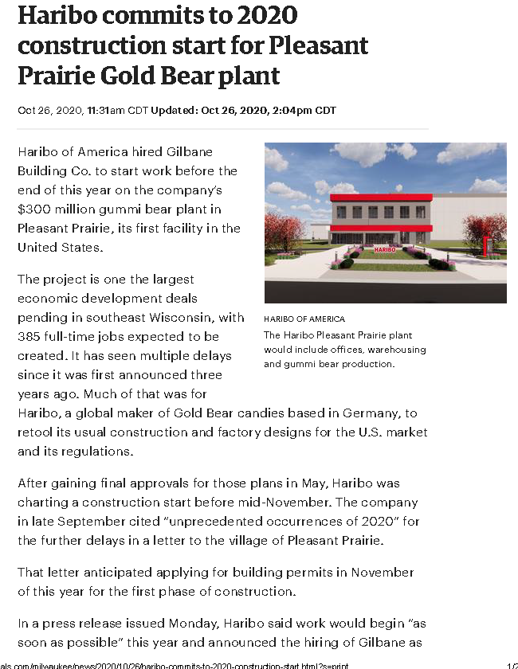
News #1
News #2
News #3
Chemicals manufacturer plans to move from Illinois to Pleasant
Illinois hand sanitzer manufactuere moving and expanding
Haribo
2020 Annual Update
Kenosha Submarket
In the News
#1
#2
#3

Slide 17
2020 Annual Update
Number of Sales & Volume
First paragraph copy. Que eate evenda archil in
eat, totaqui utecea et et maiorem fugit hari
nullandi aut rerro coremporum aliaspi taerfer
ehentem oditiberore ipsam esti dolorep ellabo.
  Body copy. Et facillab inctiorem ium dellore perchil igenditios ut aliquia qui odigenimin por rerrum voluptation consequ iberovit vent ut erae. Equideratius es rerundam nus. Di solupti sit quatestiunt. Fuga. Genda id que et facillab inctiorem ium dellore perchil igenditios ut aliquia qui odigenimin por rerrum voluptation consequ iberovit vent ut erae. Equideratius es rerundam nus. Di solupti sit quatestiunt. Fuga. Genda id que et facillab inctiorem ium dellore perchil igenditios ut aliquia qui odigenimin por rerrum voluptation consequ iberovit vent ut erae.
Notes:
Another trend: doing more with less. The number of transactions for the year slowed down considerable however the transactional volume is was higher than the average in 3 or the 4 quarters.

Slide 18
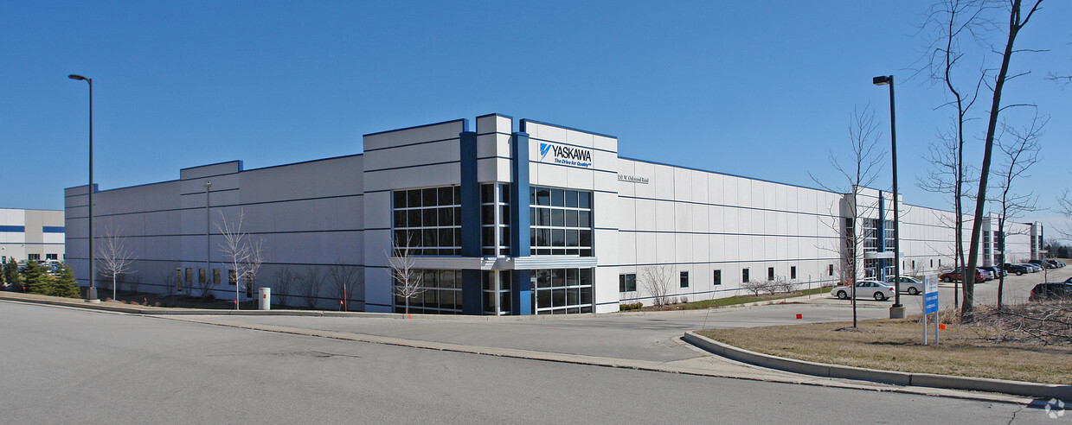
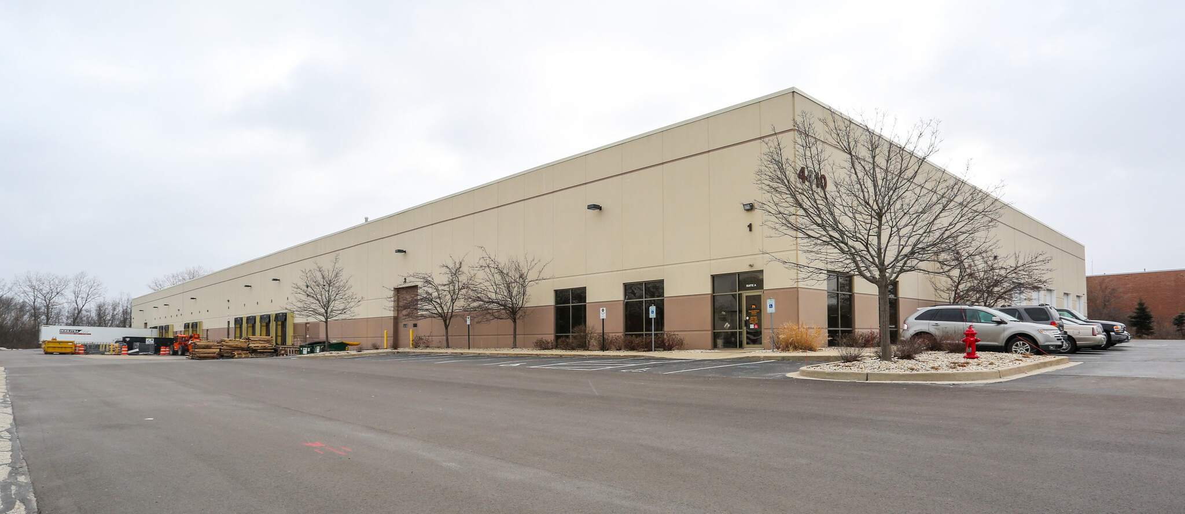
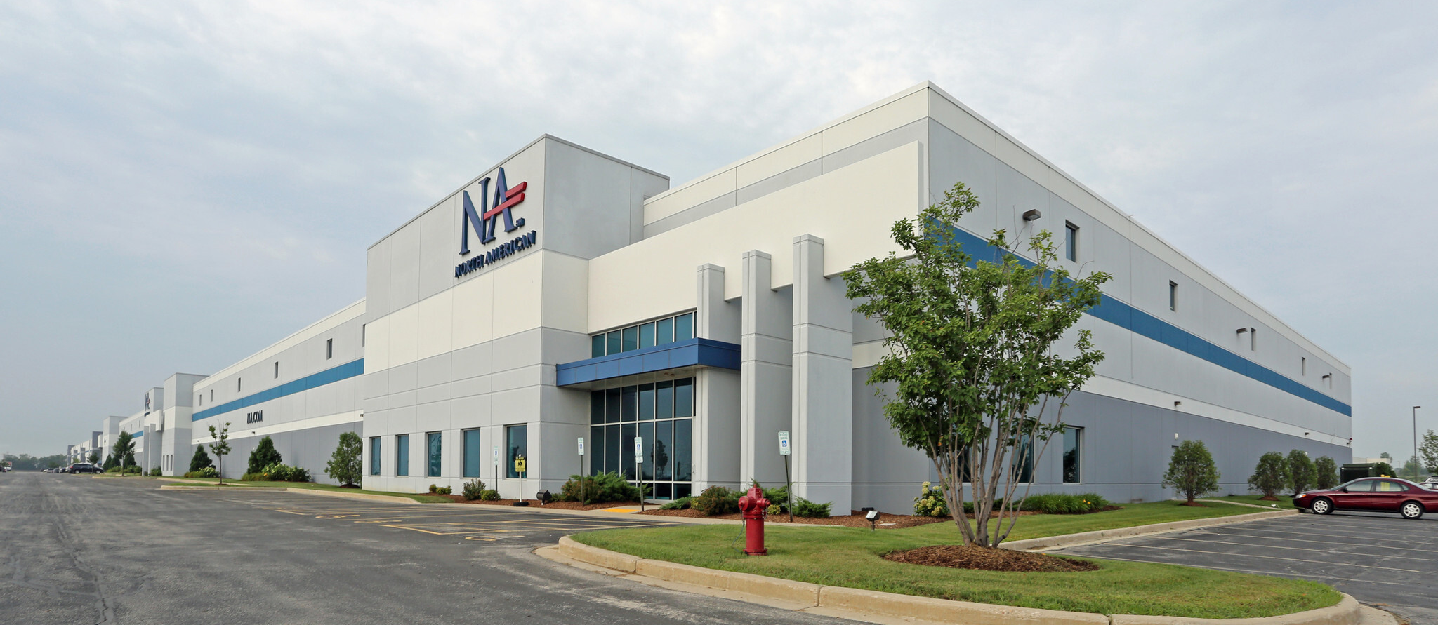
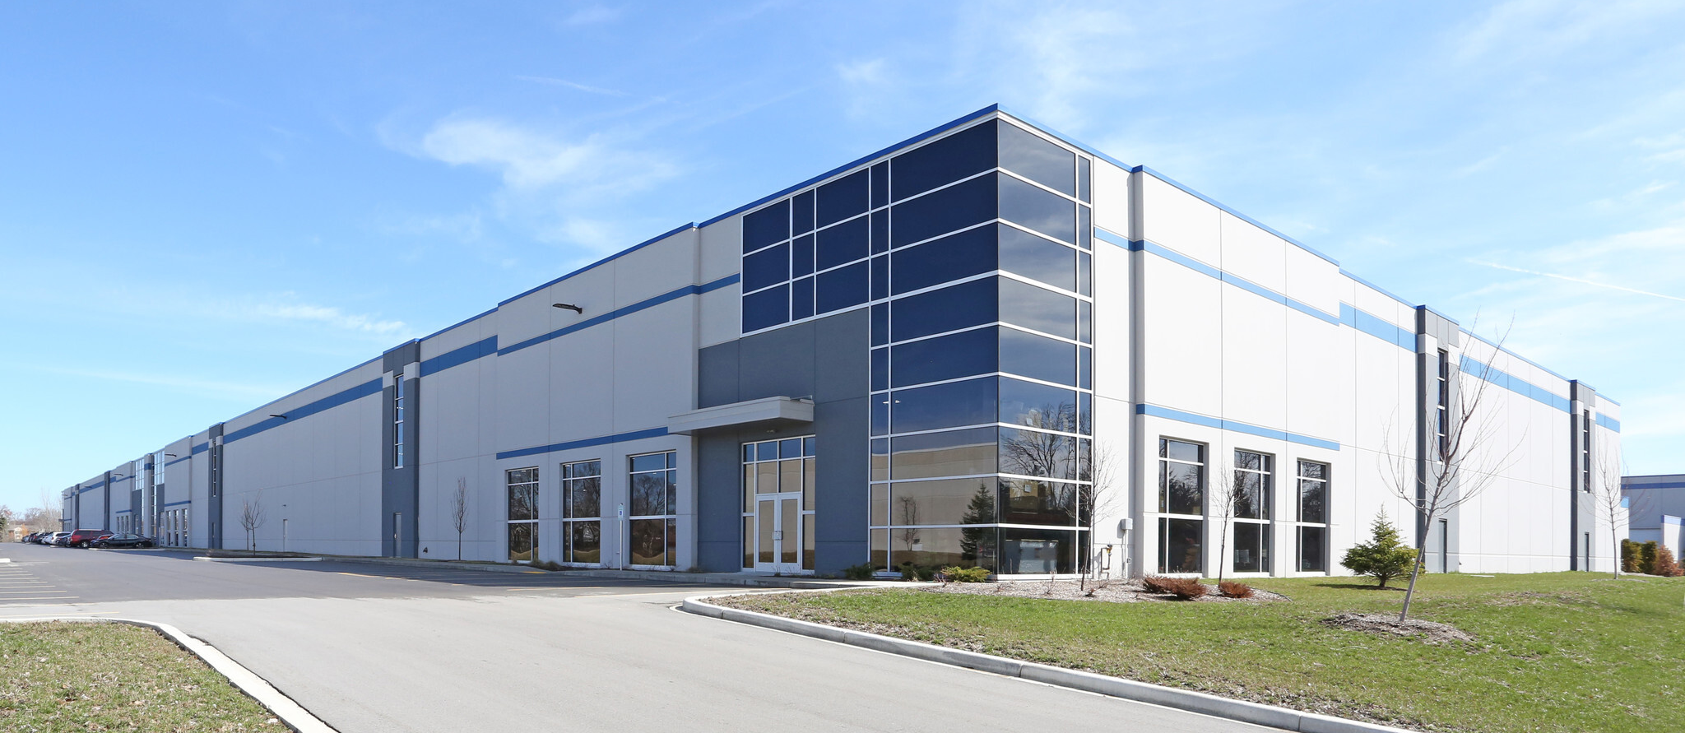
2020 Annual Update
Portfolio Transactions
Blackstone Real Estate Income
Starwood Real Estate Income
Stockbridge Capital Group LLC
WPT Industrial Real Estate Inv
27 Buildings In Il, IN & WI
34 Buildings Across the Midwest
7 Buildings Across the Midwest
4 Buildings National
14 Buildings in Wisconsin
3 Buildings in Wisconsin
2 Buildings in Wisconsin
2 Buildings in Wisconsin
5,939,505 SF
4,183,745 SF
2,859,599 SF
1,492,688 SF
$391.5M sale price
$320M sale price
$267.7M sale price
$109.3M sale price
$65.91/SF
$80.51/SF
$93.60/SF
$73.22/SF
Notes:
All four of these large national portfolio sales occurred prior to the covid shutdowns.

Slide 19
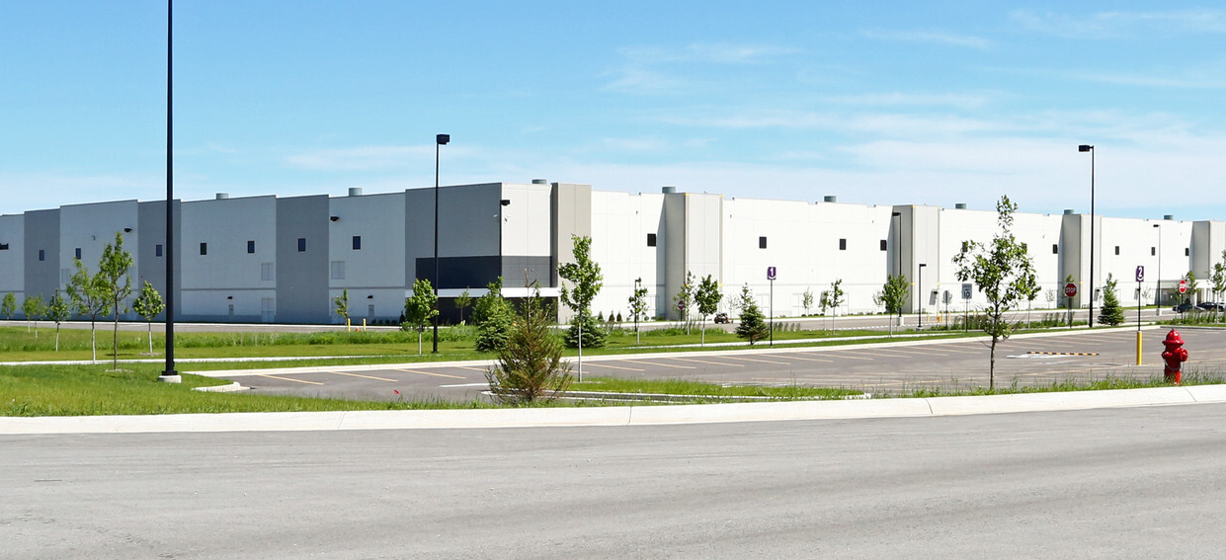
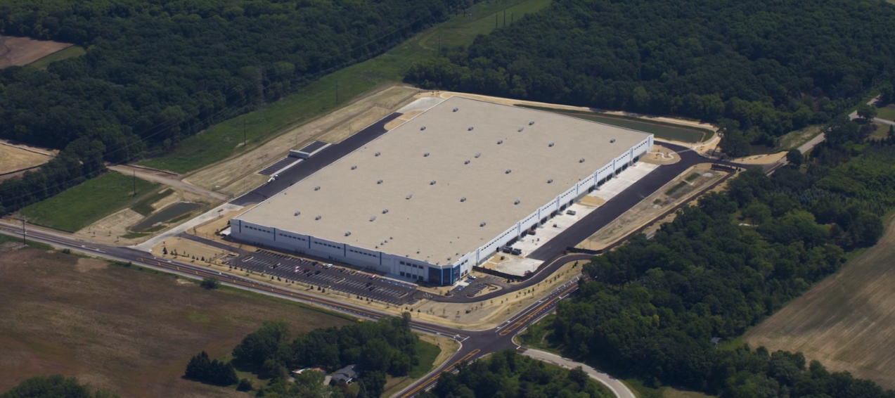
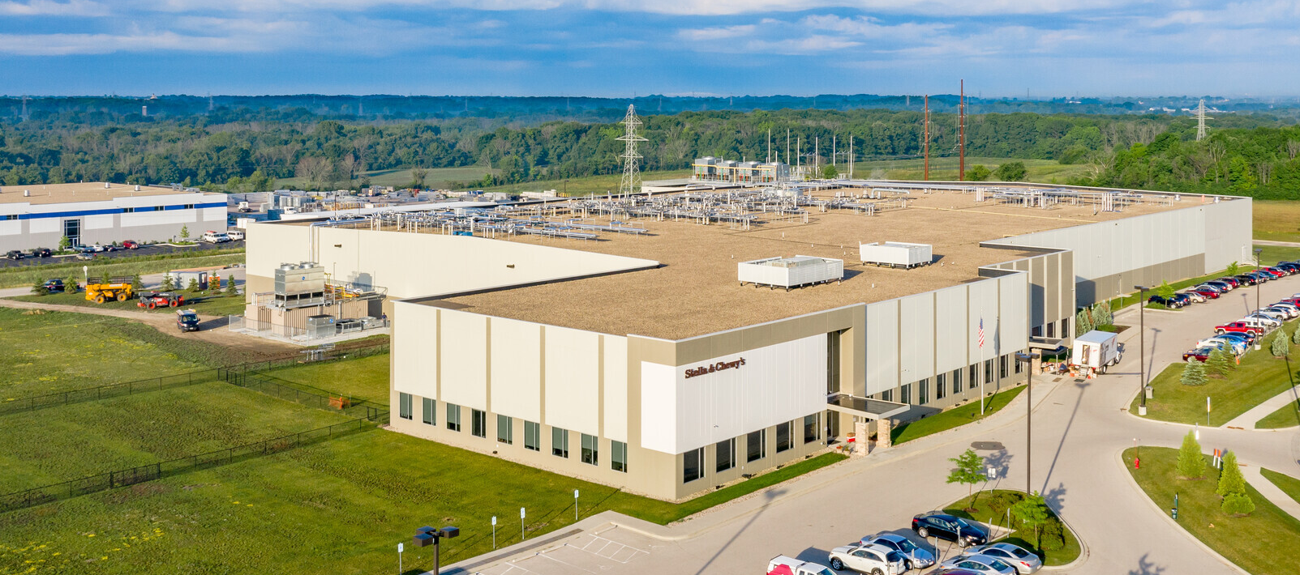
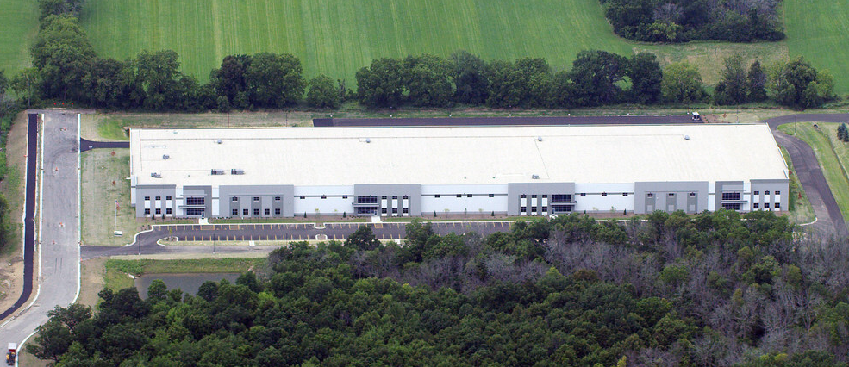
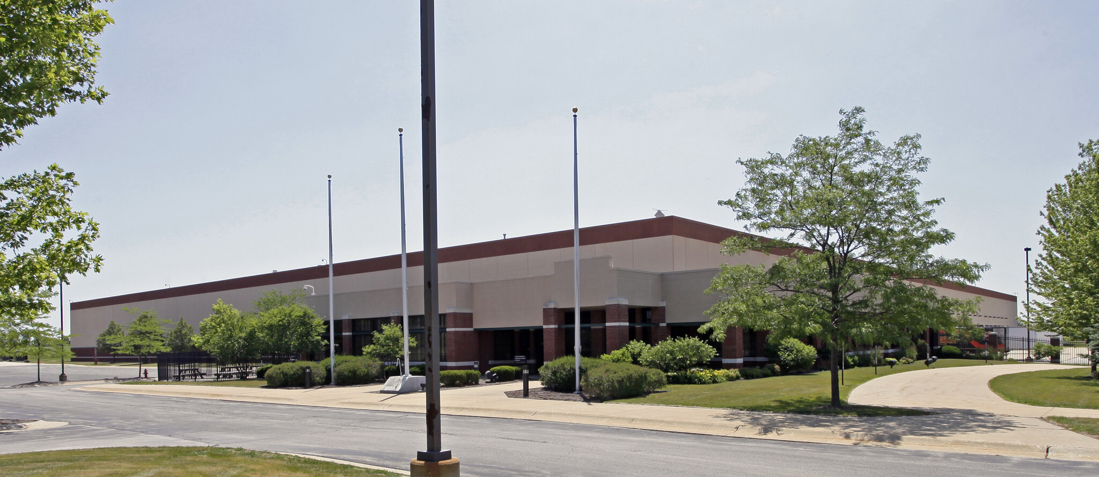
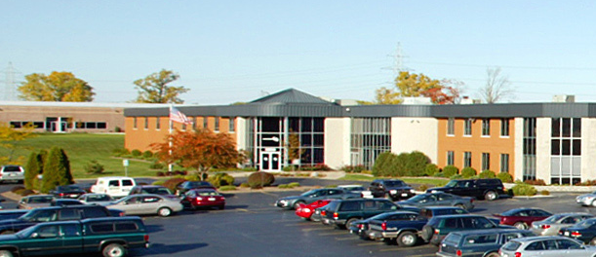
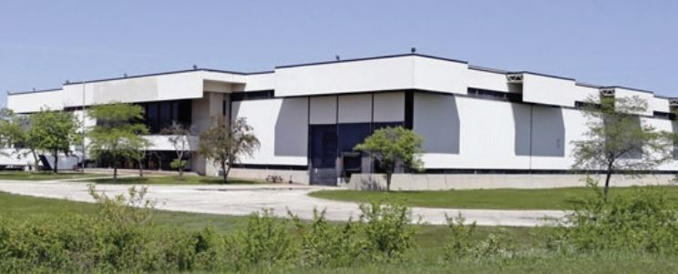
2020 Annual Update
Investment Transactions
Kohlberg Kravis Roberts & Co.
MetLife Real Estate
Stella & Chewy’s
STAG Industrial, Inc.
2 Buildings Leased by Amazon
Leased by Fresenius Kabi USA
Leased by Stella & Chewy’s
Kenosha
Pleasant Prairie
Oak Creek
New Berlin
1,529,716 SF
590,525 SF
164,007 SF
192,800 SF
$176M sale price
$54.6M sale price
$24.5M sale price
$18.5M sale price
$115.05/SF
$92.46/SF
$149.45/SF
$95.95/SF
Exeter Property Group
High Street Logistics Properties
SARA Investment Real Estate
AIC Ventures
Leased by Baptista’s
Leased by TA Chen International
Leased by AGI Fabricators
Leased by HB Performance
Franklin
Pleasant Prairie
Milwaukee
Mequon
246,348 SF
205,732 SF
181,692 SF
168,358 SF
$17.75M sale price
$15.9M sale price
$77.29/SF
$10.6M sale price
$10.5M sale price
$72.05/SF
$58.34/SF
$62.37/SF
$77.29/SF

Slide 20
2020 Annual Update
Tony’s Predictions
The Prediction | Ruling
New business park development will increase in areas we never thought we’d see development such as Big Bend, Lisbon, Franklin & Germantown, offering new expansion opportunities for owner occupants. | True
New deliveries will continue to outpace absorption | Spot on
Strauss Brands will reconsider their plans to locate in Central City in Milwaukee | I Guess
Vacancy will continue to rise, at a modest rate | True
The Milwaukee Bucks will win the NBA championship in 2020 | False

Slide 21
2020 Annual Update
Adam’s Predictions
The Prediction
Amazon will continue to expand
Investors will be very busy in 2021, but mostly from out of State. The cap rate compression (rising prices) are slowly down velocity from Wisconsin based investors.
Manufacturing business will continue to expand, outpacing it’s current contractions due to market conditions
Illinois to Wisconsin trend will continue to be strong
The Central’s Vacancy rate will decrease
Packers go to the Superbowl
Notes:
Maybe add something about the central submarket’s vacancy rate falling. Easy points.

Slide 22
Thank You

