Slide 1


Slide 2


Slide 3

2020

Slide 4
Capital Markets Overview
Economy
Top transactions and trends
Predictions

Slide 5




Global Recession

Slide 6
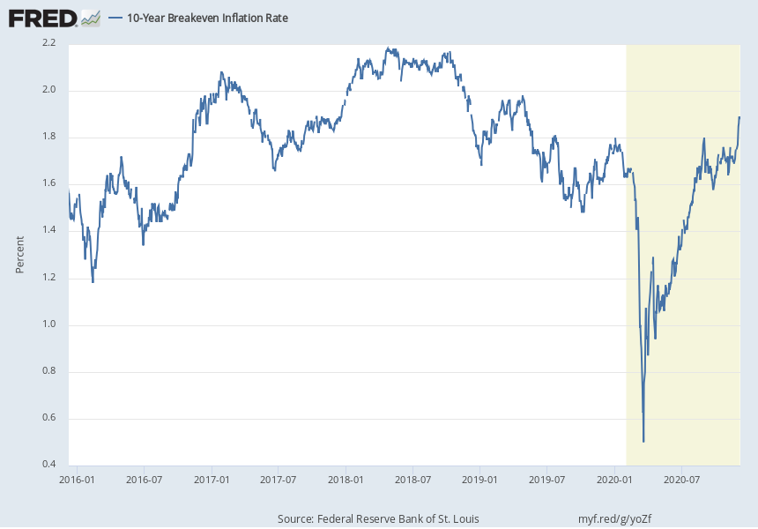

Slide 7
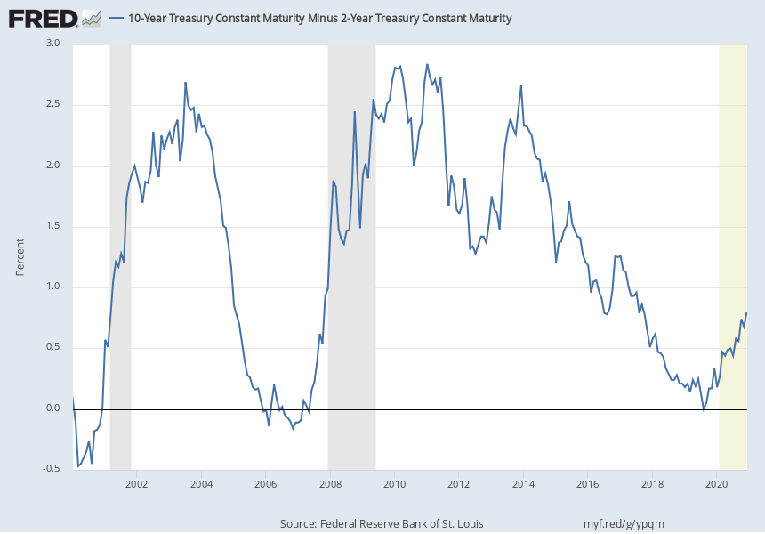

Slide 8
Year-to-Date
Sector Breakout

Slide 9
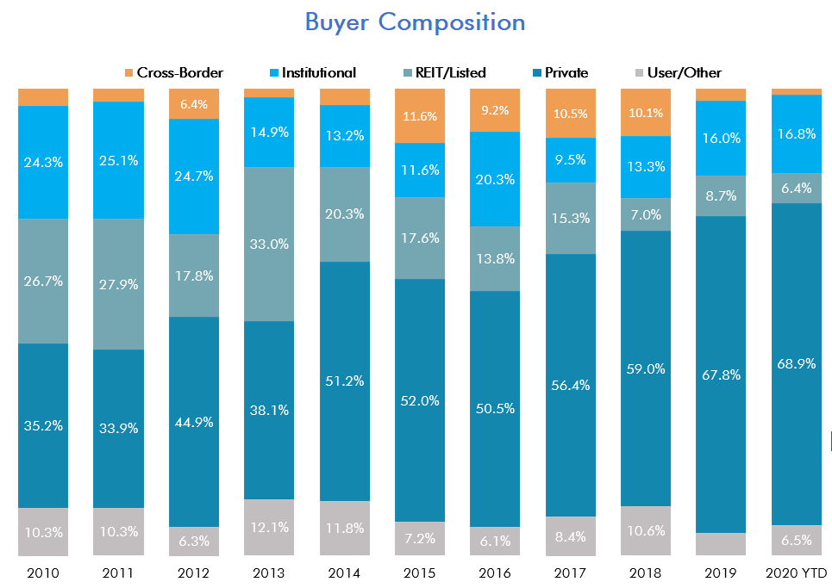
Buyer Composition
Private Capital

Slide 10
Historical Sales Volume

Slide 11
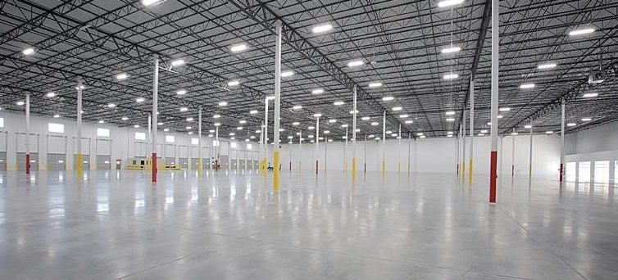
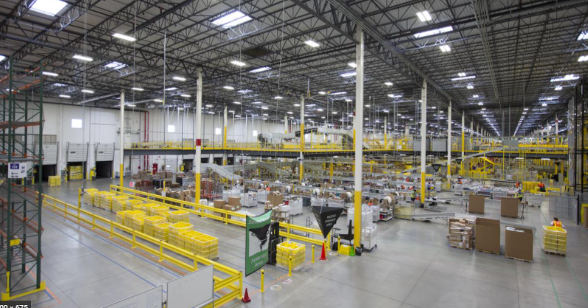
Industrial
CenterPoint Portfolio – Various Locations
$269MM
>1MM SF
Year Built: Various
Buyer: Link Industrial (formerly Blackstone)
Seller: CenterPoint Properties
Kenosha Enterprise Park – Kenosha
$176MM
>1MM SF
Year Built: 2015
Buyer: KKR
Seller: Prologis

Slide 12
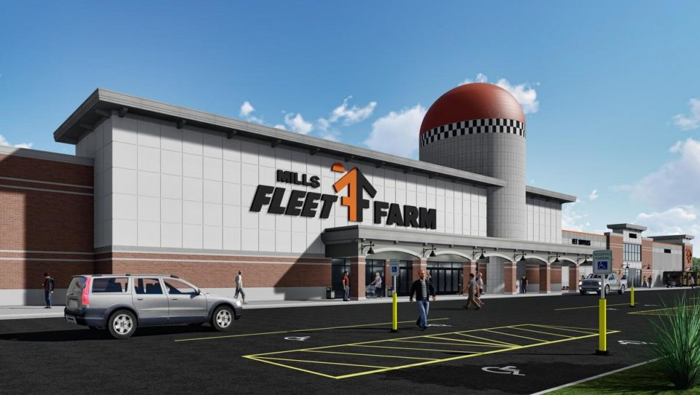
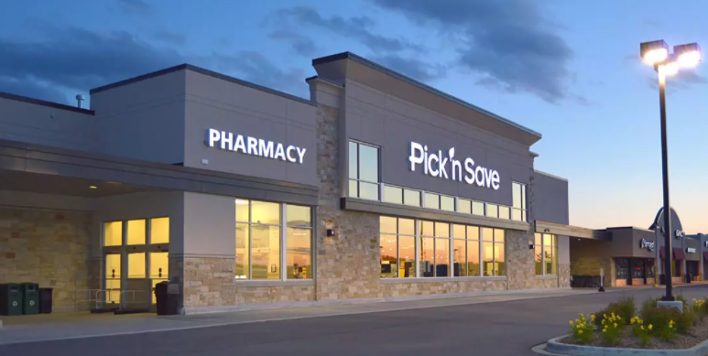
Retail
Fleet Farm - Oconomowoc
$36.4MM | $131/SF
216,628 SF
Year Built: 2018
Buyer: SR Realty Trust
Seller: Commercial Horizons
Pick ‘N Save – Menomonee Falls
$28.4MM | $274/SF
103,611 SF
Year Built: 2011
Buyer: ExchangeRight
Seller: Oak Street Capital

Slide 13

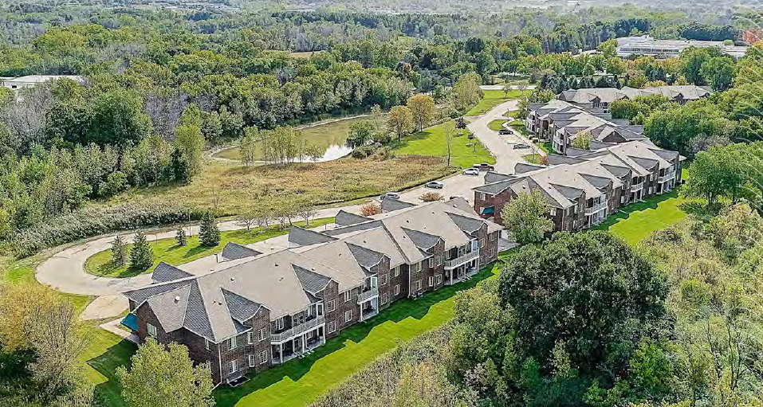
Multifamily
Lafayette Apartments - Fitchburg
$38.8MM | ~$175k/unit
222 units
Year Built: 2019
Buyer: Weidner Properties
Seller: Cascade Development
RiversEdge Apartments – Pewaukee
Undisclosed
72 units
Year Built: 1994
Buyer: Undisclosed
Seller: General Electric

Slide 14
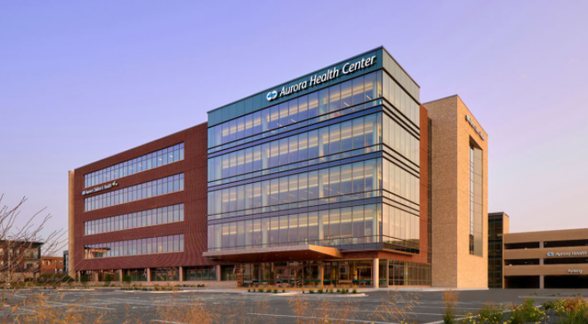
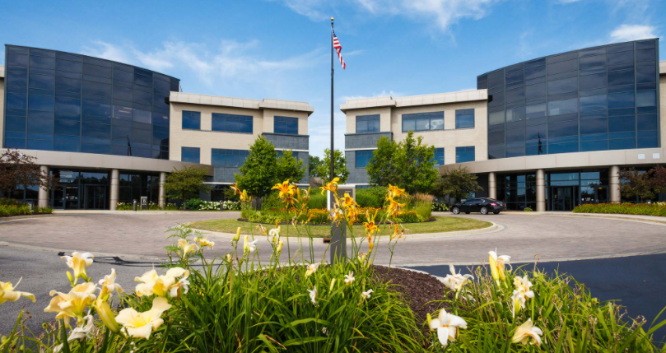
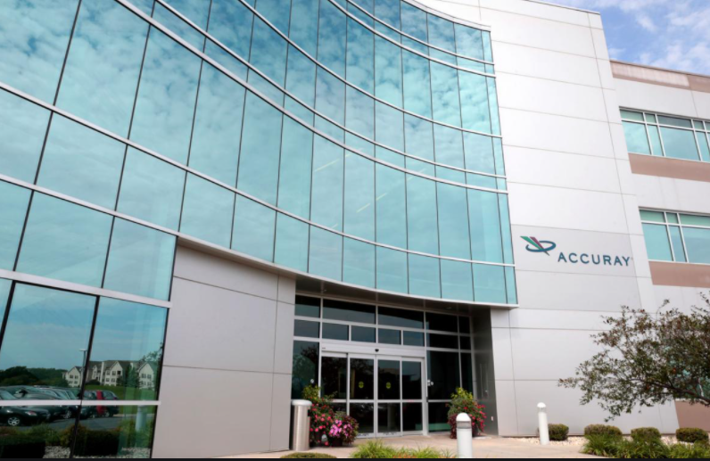
Office
Aurora Health Care - Greenfield
$74MM | $535/SF
138,200 SF
Year Built: 2019
Buyer: Montecito Medical
Seller: Cobalt Partners
Froedtert – Menomonee Falls
$59.3MM | $92/SF
119,000 SF
Year Built: 2008
Buyer: IRA Capital
Seller: Excelsior Group
Gialamas Portfolio - Madison
$23.5MM | $166/SF
141,550 SF
Year Built: Various
Buyer: SARA Investment Real Estate
Seller: The Gialamas Company

Slide 15

2020 Predictions Review
Cap rates will remain flat for 2020
Transaction volume will be down vs. 2019 - but not by much
Infrastructure investment will continue to spur more development
There will be some record cap rates hit for Net-Lease and Apartments
in Q1 and Q2 2020

Slide 16
2020 Predictions Review
Cap rates will remain flat for 2020 - FALSE
Transaction volume will be down vs. 2019 - but not by much
Infrastructure investment will continue to spur more development
There will be some record cap rates hit for Net-Lease and Apartments
in Q1 and Q2 2020

Slide 17
2020 Predictions Review
Cap rates will remain flat for 2020 - FALSE
Transaction volume will be down vs. 2019 - but not by much - FALSE
Infrastructure investment will continue to spur more development
There will be some record cap rates hit for Net-Lease and Apartments
in Q1 and Q2 2020

Slide 18
2020 Predictions Review
Cap rates will remain flat for 2020 - FALSE
Transaction volume will be down vs. 2019 - but not by much - FALSE
Infrastructure investment will continue to spur more development - TRUE
There will be some record cap rates hit for Net-Lease and Apartments
in Q1 and Q2 2020

Slide 19
2020 Predictions Review
Cap rates will remain flat for 2020 - FALSE
Transaction volume will be down vs. 2019 - but not by much - FALSE
Infrastructure investment will continue to spur more development - TRUE
There will be some record cap rates hit for Net-Lease and Apartments
in Q1 and Q2 2020 - TRUE

Slide 20

2021 Predictions
Gretchen Richards, CBRE
Increase in adaptive reuse of existing assets
Further cap rate compression for industrial/multifamily
2021 will surpass 2020 transaction volume (2019 level)
Net Lease demand continue to rise
Increase in portfolio sales across all sectors

Slide 21
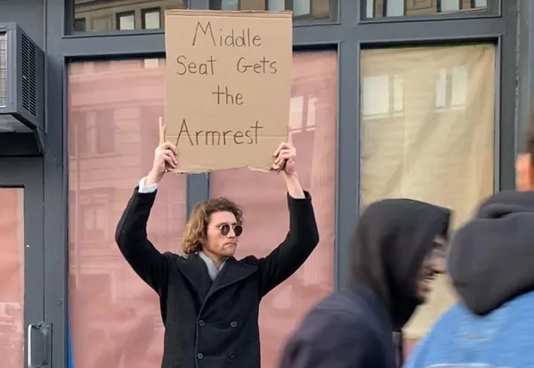
2021

