Slide 1


Slide 2


Slide 3

Overview
Retail Market by Numbers
Notable Deals & Developments
Retail Trends & Expanding Retailers
Predictions

Slide 4
Retail Market
Total Retail GLA:
42.6 MM SF
Occupied Space:
38.9 MM SF
Vacant Space:
3.7 MM SF
Vacancy Rate:
8.8%
SUBMARKET | NUMBER OF BUILDINGS | INVENTORY | TOTAL AVAILABLE | AVAILABLE % | TOTAL VACANT | VACANT %
North | 163 | 8,917,817 | 1,170,967 | 13.1% | 1,119,685 | 12.6%
West | 200 | 13,010,647 | 1,269,866 | 9.8% | 978,376 | 7.5%
Central | 132 | 8,548,966 | 683,239 | 8.0% | 631,728 | 7.4%
South | 168 | 12,180,023 | 1,047,730 | 8.6% | 1,004,770 | 8.2%
TOTAL | 663 | 42,657,453 | 4,171,802 | 9.8% | 3,734,559 | 8.8%
COMPARED TO 2019 | +1 | +209,131 | +158,899 | +0.3% | +622,475 | +1.4%

Slide 5
Retail Trends
Big Box Closures
Convenience
Banks & Credit Unions Expanding
Retailers Struggling

Slide 6
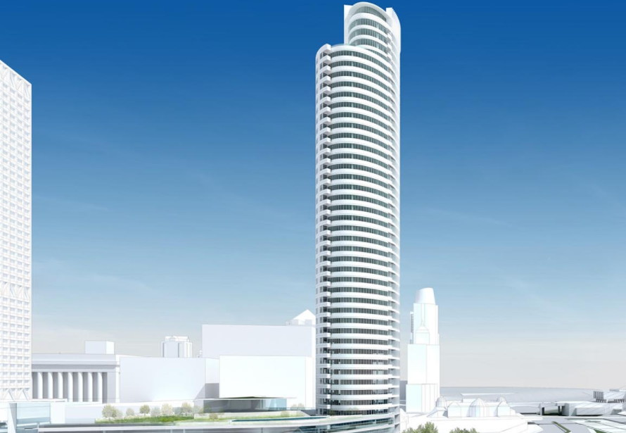
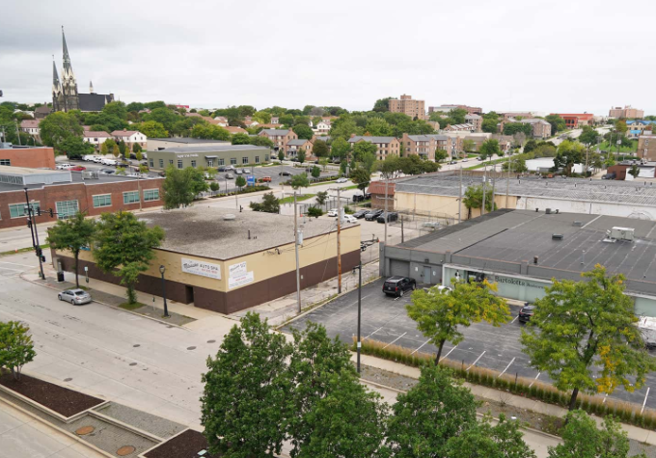
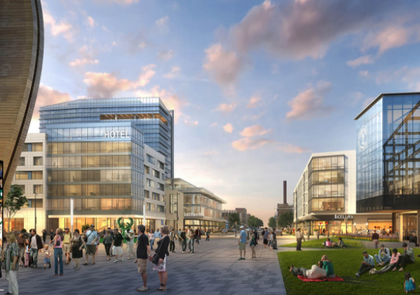
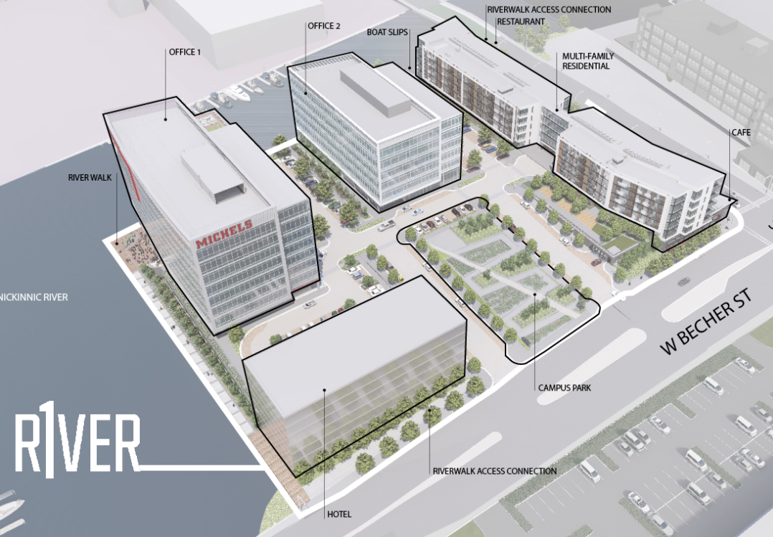
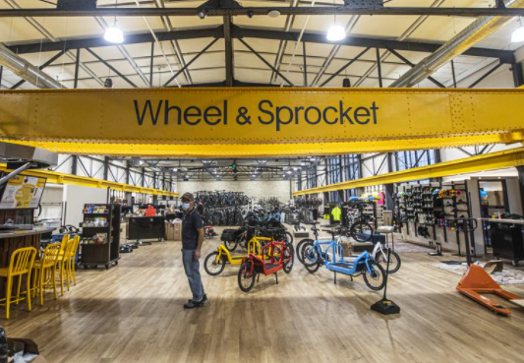



Central Retail Market
INVENTORY SF | TOTAL VACANT SF | VACANCY RATE
8,549,966 | 631,728 | 7.4%
Notes:
Addition of Kinetik apartments – Flour & Feed and Gathering Place Brewing Company

Slide 7








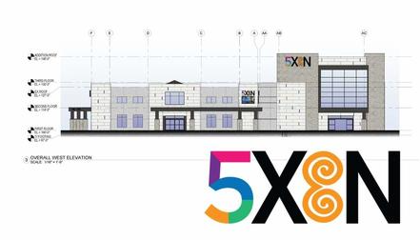







North Retail Market
INVENTORY SF | TOTAL VACANT SF | VACANCY RATE
8,917,817 | 1,119,685 | 12.6%
Bayshore Mall
Mequon
Northwest Side
Banks & Credit Unions
Grafton

Slide 8














West Retail Market
INVENTORY SF | TOTAL VACANT SF | VACANCY RATE
13,010,617 | 978,376 | 7.5%
Notes:
I like the squares on the previous page for North Retail Market – can you incorporate that into this slide and South?

Slide 9


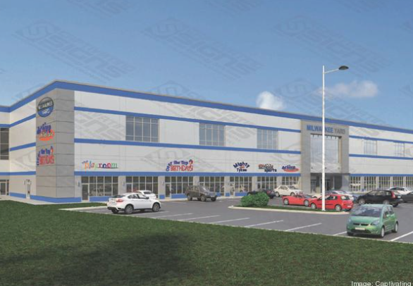


South Retail Market
INVENTORY SF | TOTAL VACANT SF | VACANCY RATE
12,180,023 | 1,004,770 | 8.2%
Milwaukee Yards

Slide 10



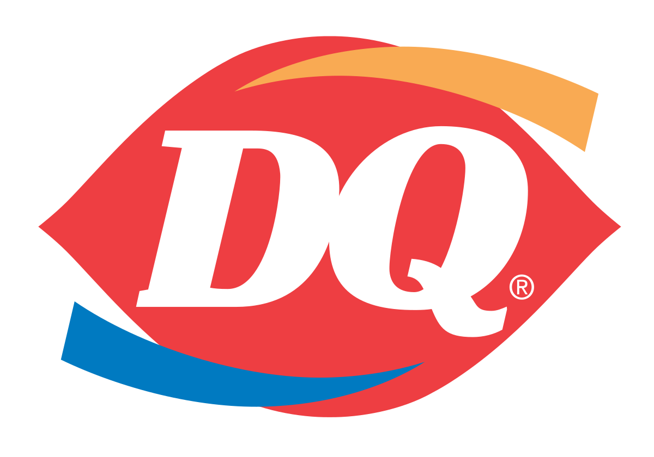







Retailers Expanding

Slide 11










Local Retailers Evolving Due to COVID

Slide 12
2020 Retail Predictions- Max Jacobson
Several of the boutique fitness concepts will close their doors
Marijuana will NOT be legalized in WI
Leasing velocity at the Deer District (Bucks Arena) will skyrocket after the Bucks win the NBA 2020 Championship

Slide 13
2021 Retail Predictions- Kelly Rodenkirk
Vacancy rates will continue to increase
Local restaurants will continue to close, but will come back stronger than ever
2021 will bring the end of “virtual happy hours”

